Slide 1
THERMAL ENGINEERING - II

Slide 2
Module 1: (15 hours)
Properties of steam: use of steam tables and Mollier chart; separating and throttling calorimeter; properties of atmospheric air; psychrometric chart; energy scenario: national and global; vapour and combined power cycle; Carnot vapour cycle; ideal Rankine cycle; deviations in an actual Rankine cycle; methods to increase the efficiency of Rankine cycle, reheat and regenerative cycles; open and closed feed water heaters; deaerator; co-generation; combined gas power cycles; vapour compression refrigeration cycle: ideal and actual; air refrigeration cycle; components and systems.

Slide 3
Module 2: (11 hours)
Steam generators: fire tube, Lancashire, locomotive and Nestler boilers; water-tube; Babcock and Wilcox and bent-tube boilers; mountings and accessories; schematic diagram of a modern steam generator; combustion equipment; overfeed and underfeed stokers; travelling-grate and spreader stokers, pulverized coal burners, cyclone furnace, fluidized-bed combustion; coal based synthetic fuels;
Steam nozzles: condition for maximum discharge, design for throat and exit areas, effect of friction, supersaturated flow.

Slide 4
Module 3: (13 hours)
Steam turbines: classification, impulse and reaction turbines; velocity diagrams, efficiencies, end thrust, blade height; turbine performance and governing;
condensers: surface and mixing condensers; solution of problems on evaporative cooling towers and wet cooling towers; different types of modern wet and dry cooling towers; power plant economics; load curve and load duration curve, load factor, diversity factor, capacity factor and use factor, depreciation and replacement; environmental aspects of thermal power systems; dust collectors; waste heat recovery techniques.

Slide 5
References:
Y. A. Cengel and M. A. Boles, Thermodynamics - An engineering approach, 4th ed., Tata McGraw Hill, 2005.
2. M. M. El-Wakil, Power Plant Engineering, 1st ed. McGraw Hill, 1985.
3. W. A. Vopat and B. G. A. Skrotzki, Power Station Engineering and Economy. Tata McGra Hill, 1999.
4. P. K. Nag, Power Plant Engineering, 4th ed. McGraw Hill, 2017.
5. W. F. Stoecker and J.W. Jones, Refrigeration & Air Conditioning, 2nd ed. McGraw Hill, 1983.
6. C. P. Arora, Refrigeration & Air Conditioning, 3rd ed. McGraw Hill, 2008

Slide 6
Course outcomes
CO1: Apply thermodynamic cycles to steam power plant and refrigeration systems.
CO2: Develop thermal refinement methods for performance improvement of steam power plant.
CO3: Analyse the components of steam power plant and refrigeration systems.
CO4: Acquire knowledge on pollution control methods.

Slide 7
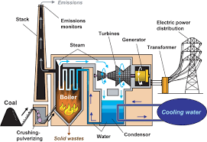
STEAM POWER PLANT

Slide 8
Energy Scenario of India
Installed power capacity of India as on 9-1-2019 (3,57,875 MW) :
Coal – 58.3%
Gas – 7.6%
Oil – 0.3%
Hydel – 13.6%
Nuclear – 2%
RES – 18.2%
Different shares:
State sector – 24.4%
Central sector – 31.1%
Private Sector – 44.5%

Slide 9
CO2 Emissions per kWh energy :
Coal - 0.98 kg/kWh
Gas – 0.52 kg/kWh
Oil – 0.77 kg/kWh
Advantage of nuclear power:
1 kg of coal generates 8 kWh of heat where as 1 kg of uranium 235 generates 2,40,00000 kWh heat by fission

Slide 10
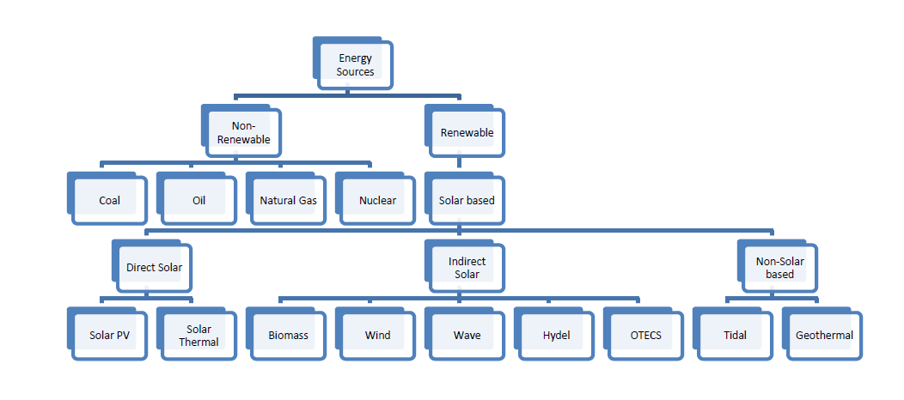
CLASSIFICATION OF ENERGY RESOURCES

Slide 11
Types of Steam power plants
1. Central power stations :
Power generated is for general sale
Also called Condensing power plants
2. Captive power stations / Co- Generation plants :
Power generated is for industries internal usage
Also called Non – Condensing type

Slide 12
Steam power plant
It is a heat engine
It is an external combustion engine
Definition of IC and EC engines
Definition of IC Engine:
Examples: SI and CI Engines
Definition of EC Engine:
Example: Steam power plant and closed cycle gas turbine power plant (CCGTPP)

Slide 13
Steam is an important medium of producing mechanical energy.
Steam has the following advantages:
It can be raised from water which is available in abundance,
It does not react much with the materials of the equipment of power plant and
It is stable at the temperature required in the plant.
Steam is used to drive steam engines, steam turbines etc.

Slide 14
Steam power station is most suitable where coal is available in abundance.
Thermal electrical power generation is one of the major method.
Out of total power developed in India about 66% is thermal based.

Slide 15
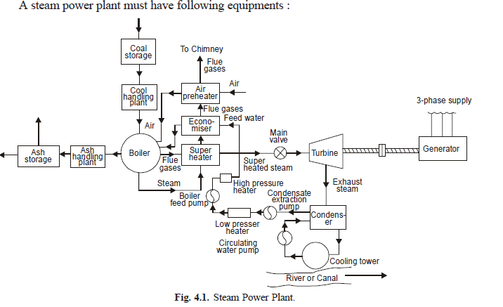

Slide 16
A steam power plant must have following equipments :
A furnace to burn the fuel.
2. Steam generator or boiler containing water.
Heat generated in the furnace is utilized to convert
water in steam.
3. Main power unit such as an engine or turbine to use the heat of steam and perform work.
4. Piping system to convey steam and water.

Slide 17
The flow sheet of a thermal power plant consists of the following four main circuits :
(i) Feed water and steam flow circuit
(ii) Coal and ash circuit
(iii) Air and gas circuit
(iv) Cooling water circuit.
A steam power plant using steam as working substance works basically on Rankine cycle.
Steam is generated in a boiler, expanded in the prime mover, condensed in the condenser and fed into the boiler again.

Slide 18
Properties of a pure substance
Assume a unit mass of ice (solid water) at -10°C and 1 atm contained in a cylinder and piston machine (Fig. 9.1).
Let the ice be heated slowly so that its temperature
is always uniform.
The changes which occur in the mass of water would be traced as the temperature is increased while the pressure is held constant.
Let the state changes of water be plotted on p-v coordinates.
The distinct regimes of heating, as shown in Fig. 9.2, are:

Slide 19
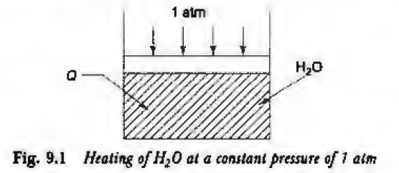

Slide 20
1-2 The temperature of ice increases from - 10°C to 0°C.
The volume of ice would increase, as would be the case for any solid upon heating.
At state 2, i.e. 0°C, the ice would start melting.
2-3 ice melts into water at a constant temperature of 0°C.
At state 3, the melting process ends.
There is a decrease in volume, which is a peculiarity of
water.

Slide 21
3-4 The temperature of water increases, upon heating, from 0°C to 100°C.
The volume of water increases because of thermal expansion.
4-5 The water starts boiling at state 4 and boiling ends at state 5.
This, phase change from liquid to vapour occurs at a constant temperature of 100°C (the pressure being constant at 1 atm).
There is a large increase in volume.
5-6 The vapour is heated to, say, 250°C (state 6).
The volume of vapour increases from v5 to v6.

Slide 22
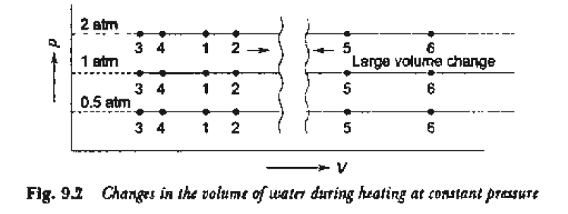

Slide 23
Water existed in the solid phase between 1 and 2, in the liquid phase between 3 and 4, and in the gas phase beyond 5.
Between 2 and 3, the solid changed into the liquid phase by absorbing the latent heat of fusion and between 4 and 5, the liquid changed into the vapour phase by absorbing the latent heat of vaporization,
both at constant temperature and pressure.

Slide 24
The states 2, 3, 4 and 5 are known as saturation states.
A saturation state is a state from which a change of phase may occur without a change of pressure or temperature.
State 2 is a saturated solid state because a solid can change into liquid at constant pressure and temperature from state 2.

Slide 25
States 3 and 4 are both saturated liquid states.
In state 3, the liquid is saturated with respect to solidification, whereas in state 4, the liquid is saturated with respect to vaporization.
State 5 is a saturated vapour state, because from state 5, the vapour can condense into liquid without a change of pressure or temperature.

Slide 26
If the heating of ice at -10°C to steam at 250°C were done at a constant pressure of 2 atm, similar regimes of heating would have been obtained with similar saturation states 2, 3, 4 and 5, as shown in Fig. 9.2.
All the state changes of the system can similarly be plotted on the p-v coordinates, when it is heated at different constant pressures.
All the saturated solid states 2 at various pressures
are joined by a line, as shown in Fig. 9 .3.

Slide 27
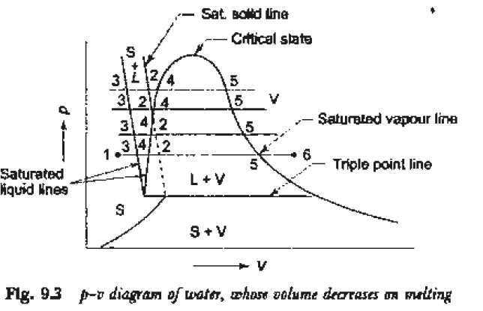

Slide 28
Similarly, all the saturated liquid states 3 with respect to solidification, all the saturated liquid states 4 with respect to vaporization, and all the saturated vapour states 5, are joined together.
Figure 9.4 shows state changes of a pure substance other than water whose volume increases on melting.
The line passing through all the saturated solid states 2 (Figs 9.3 and 9.4) is called the saturated solid line.

Slide 29
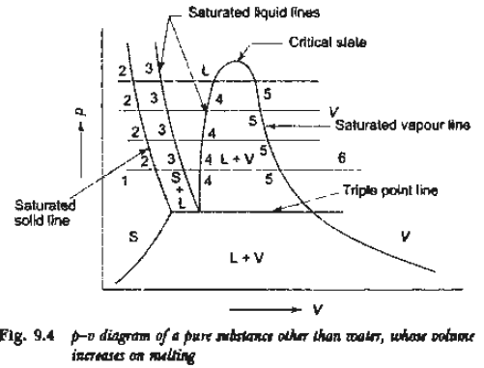

Slide 30
The lines passing through all the saturated liquid states 3 and 4 with respect to solidification and vaporization respectively are known as the saturated liquid lines.
The line passing through all the saturated vapour states 5, is the saturated vapour line.
The saturated liquid line with respect to vaporization and the saturated vapour line incline towards each other and form what is known as the saturation or vapour dome.
The two lines meet at the critical state.

Slide 31
Liquid is, most often, the working fluid in power cycles, etc. and interest is often confined to the liquid-vapour regions only.
So to locate the state points, the solid regions from Figs 9.3 and 9.4 can be omitted.
The p-v diagram then becomes as shown in Fig. 9.5.

Slide 32
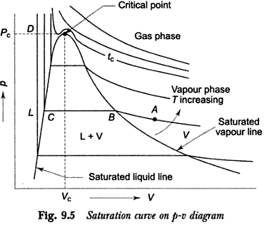

Slide 33
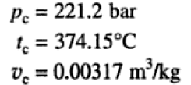
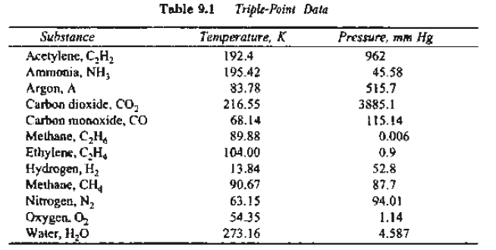

Slide 34

h-s DIAGRAM or MOLLIER DIAGRAM FOR A PURE SUBSTANCE
From the first and second laws of thermodynamics, the following property relation was obtained:

Slide 35
This equation forms the basis of the h-s diagram of a pure substance, also called the Mollier diagram.
The slope of an isobar on the h-s coordinates is equal to the absolute saturation temperature (tsat + 273) at that pressure.
If the temperature remains constant the slope will remain constant.
If the temperature increases, the slope of the isobar will increase.

Slide 36
Consider the heating of a system of ice at - 5°C to steam at 250°C, the pressure being maintained constant at 1 atm.
The slope of the isobar of 1 atm on the h-s coordinates (Fig. 9.14) first increases as the temperature of the ice increases from -5°C to 0°C (1-2).
Its slope then remains constant as ice melts into water at the constant temperature of 0°C (2-3).
The slope of the isobar again increases as the temperature of water rises from 0°C to 100°C (3-4).

Slide 37
The slope again remains constant as water vaporises into steam at the constant temperature of 100°C ( 4-5).
Finally, the slope of the isobar continues to increase as the temperature of steam increases to 250°C (5-6) and beyond.
Similarly, the isobars of different pressures can be drawn on the h-s diagram as shown in Figs. 9.14 and 9.15.
States 2, 3, 4 and 5 are saturation states.
Figure 9.15 shows the phase equilibrium diagram of a pure substance on the h-s coordinates, indicating the saturated solid line, saturated liquid lines and saturated vapour line, the various phases, and the transition (mixture) zones.

Slide 38
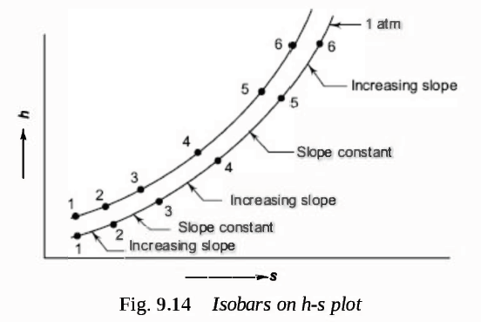

Slide 39
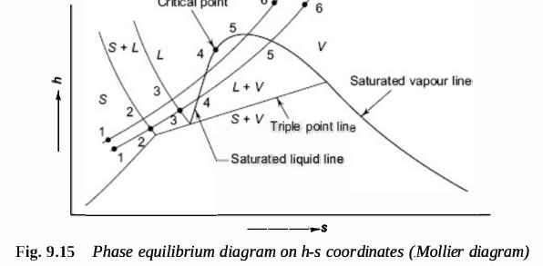

Slide 40
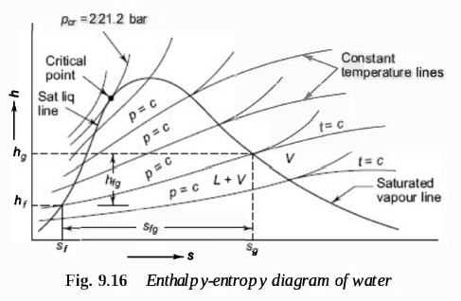

Slide 41

QUALITY OR DRYNESS FRACTION
If in 1 kg of liquid-vapour mixture, x kg is the mass of vapour and ( 1 - x ) kg is the mass of liquid, then x is known as the quality or dryness fraction of the liquid vapour mixture.
Therefore, quality indicates the mass fraction of vapour in a liquid vapour mixture or

Slide 42
where mv and ml are the masses of vapour and liquid respectively in the mixture.
The value of x varies between 0 and 1.
For saturated water, when water just starts boiling, x = 0, and for saturated vapour, when vaporisation is complete, x = 1, for which the vapour is said to be dry saturated.

Slide 43
Points m in Fig. 9.17 (a), (b), and (c) indicate the saturated liquid states with x = 0, and points n indicate the saturated vapour states with x = 1, the lines mn indicating the transition from liquid to vapour.
Points a, b, and c at various pressures indicate the situations when the masses of vapour reached 25%, 50%, and 75% of the total mass, i.e., at points a, the mass of liquid is 75% and the mass of vapour is 25% of the total mass, at points b, the mixture consists of 50% liquid and 50% vapour by mass, and at points c, the mixture consists of 75% vapour and 25% liquid by mass.
The lines passing through points a, b and c are the constant quality lines of 0.25, 0.50, and 0. 75 respectively.
Constant quality lines start from the critical point.

Slide 44
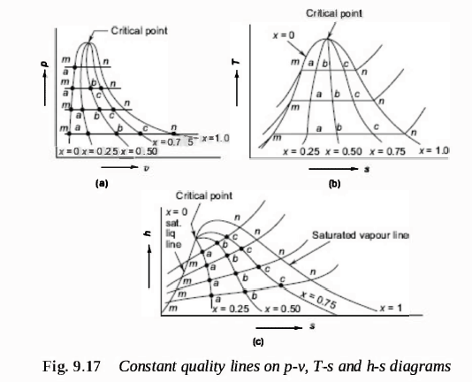

Slide 45
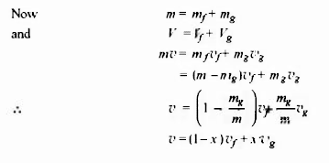
Let V be the total volume of a liquid vapour mixture of quality x, Vf the volume of the saturated liquid, and Vg the volume of the saturated vapour, the corresponding masses being m, mf and mg respectively.

Slide 46

where x = mg/m , vf, = specific volume of saturated liquid, vg = specific volume of saturated vapour, and v = specific volume of the mixture of quality x.
Similarly,

Slide 47
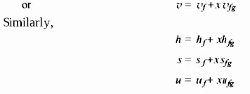

Slide 48
MEASUREMENT OF STEAM QUALITY

Slide 49
THROTTLING CALORIMETER
In the throttling calorimeter, a sample of wet steam of mass m and at pressure p1 is taken from the steam main through a perforated sampling tube (Fig. 9.23).
Then it is throttled by the partially-opened valve (or orifice) to a pressure p2, measured by mercury manometer, and temperature t2, so that after throttling the steam is in the superheated region.

Slide 50
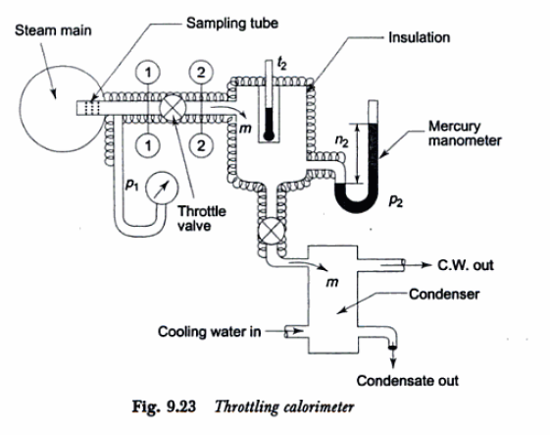

Slide 51
The process is shown on the T-s and h-s diagrams in Fig. 9.24.
The steady flow energy equation gives the enthalpy after throttling as equal to enthalpy before throttling.
The initial and final equilibrium states 1 and 2 are joined by a dotted line since throttling is irreversible (adiabatic but not isentropic) and the intermediate states are non-equilibrium states not describable by thermodynamic coordinates.

Slide 52
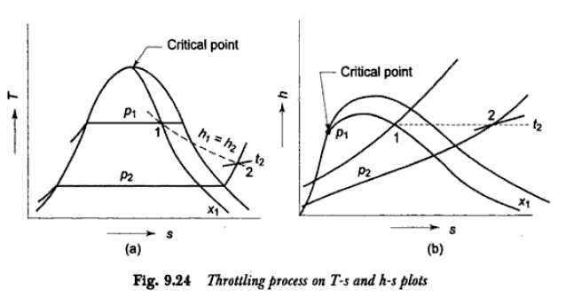

Slide 53
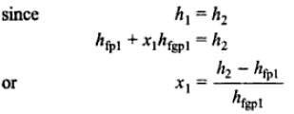
The initial state (wet) is given by p1 and x1, and the final state by P2 and t2 (superheated).

Slide 54
With p2 and t2 being known, h2 can be found out from the superheated steam table.
The values of hf and hfg are taken from the saturated steam table corresponding to pressure p1.
Therefore, the quality of the wet steam x1 can be calculated.

Slide 55
COMBINED SEPARATING AND THROTTLING CALORIMETER
When the steam is very wet and the pressure after throttling is not low enough to take the steam to the superheated region, then a combined separating and throttling calorimeter is used for the measurement of quality.

Slide 56
Steam from the main is first passed through a separator (Fig. 9.26).
In separator some part of the moisture separates out due to the sudden change in direction and falls by gravity.
The partially dry vapour is then throttled and taken to the superheated region.

Slide 57

In Fig. 9.27, process 1-2 represents the moisture separation from the wet sample of steam at constant pressure p1 and process 2-3 represents throttling to pressure p2•
With p2 and t3 being measured, h3 can be found out from the superheated steam table.
Now,

Slide 58
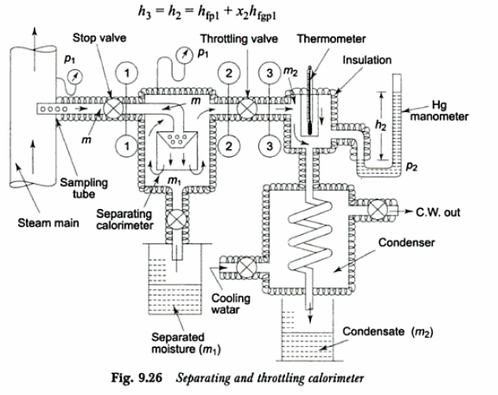

Slide 59
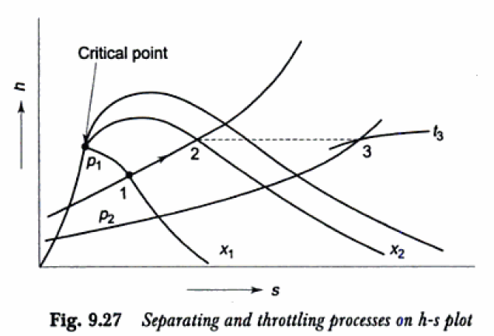

Slide 60
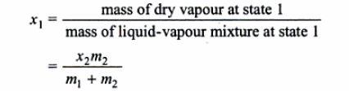
Therefore, x2, the quality of steam after partial moisture separation, can be evaluated.
If m kg of steam is taken through the sampling tube in t secs, m1 kg of it is separated, and m2 kg is throttled and then condensed to water and collected, then
m = m1 + m2, and at state 2, the mass of dry vapour will be x2m2.
Therefore, the quality of the sample of steam at state 1, x1 is given by

Slide 61
ELECTRIC CALORIMETER
The quality of wet steam can also be measured by an electric calorimeter (Fig. 9.28).
The sample of steam is passed in steady flow through an electric heater, as shown.
The electrical energy input Q should be sufficient to take the steam to the superheated region where pressure p2 and temperature t2 are measured.

Slide 62
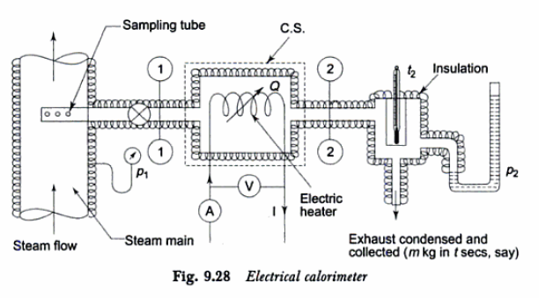

Slide 63
If I is the current flowing through the heater in amperes and V is the voltage across the coil, then at steady state Q = VI x 10-3 kW.
If m is the mass of steam taken in t seconds under steady flow condition, then the steady flow energy equation for the heater (as control volume) gives

Slide 64
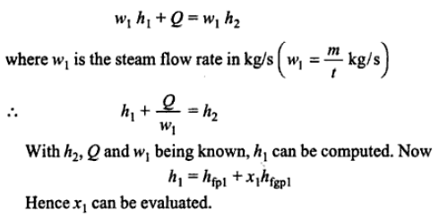

Slide 65
VAPOUR POWER CYCLE RANKINE CYCLE CARNOT CYCLE

Slide 66
VAPOUR POWER CYCLE
A power cycle continuously converts heat (energy released by the burning of fuel) into work (shaft work), in which a working fluid repeatedly performs a succession of processes.
In the vapour power cycle, the working fluid, which is water, undergoes a change of phase.
Figure 12.1 gives the schematic of a simple steam power plant working on the vapour power cycle.
Heat is transferred to water in the boiler from an external source (furnace, where fuel is continuously burnt) to raise steam, the high pressure, high temperature steam leaving the boiler expands in the turbine to produce shaft work, the steam leaving the turbine condenses into water in the condenser (where cooling water circulates), rejecting heat, and then the water is pumped back to the boiler.

Slide 67
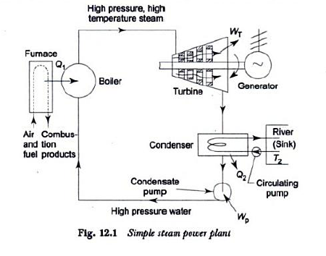

Slide 68
Figure 12.2 shows how a unit mass of the working fluid, sometimes in the liquid phase and sometimes in the vapour phase, undergoes various external heat and work interactions in executing a power cycle.
Since the fluid is undergoing a cyclic process, there will be no net change in its internal energy over the cycle, and consequently the net energy transferred to the unit mass of the fluid as heat during the cycle must equal the net energy transfer as work from the fluid.
Figure 12.3 shows the cyclic heat engine operating on the vapour power cycle, where the working substance, water, follows along the B-T-C-P(Boiler-Turbine-Condenser-Pump) path, interacting externally as shown, and converting net heat input to net work output continuously. By the first law…

Slide 69
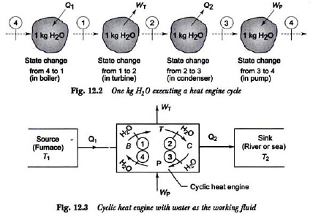

Slide 70
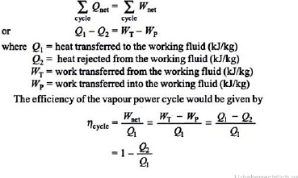

Slide 71
Rankine Cycle
For each process in the vapour power cycle, it is possible to assume a hypothetical or ideal process which represents the basic intended operation and involves no extraneous effects.
For the steam boiler, this would be a reversible constant pressure heating process of water to form steam,
For the turbine - a reversible adiabatic expansion of steam,
For the condenser - a reversible constant pressure heat rejection as the steam condenses till it becomes saturated liquid, and
For the pump, reversible adiabatic compression of this liquid ending at the initial pressure.

Slide 72
When all these four processes are ideal, the cycle is an ideal cycle, called a Rankine cycle. This is a reversible cycle.
Figure 12.4 shows the flow diagram of the Rankine cycle, and in Fig. 12.5, the cycle has been plotted on the p-v, T-s, and h-s planes.
The numbers on the plots correspond to the numbers on the flow diagram.
For any given pressure, the steam approaching the turbine may be dry saturated (state 1), wet(state 1'), or superheated (state 1"), but the fluid approaching the pump is, in each case, saturated liquid (state 3).
Steam expands reversibly and adiabatically in the turbine from state 1 to state 2 (or 1' to 2', or 1" to 2"), the steam leaving the turbine condenses to water in the condenser reversibly at constant pressure from state 2 (or 2', or 2") to state 3, the water at state 3 is then pumped to the boiler at state 4 reversibly and adiabatically, and the water is heated in the boiler to form steam reversibly at constant pressure from state 4 to state 1 (or 1' or 1").

Slide 73
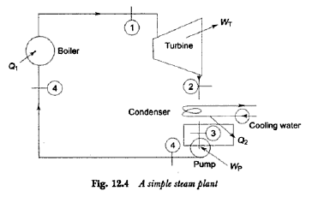

Slide 74
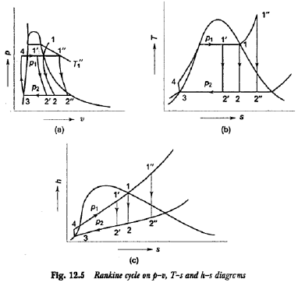

Slide 75
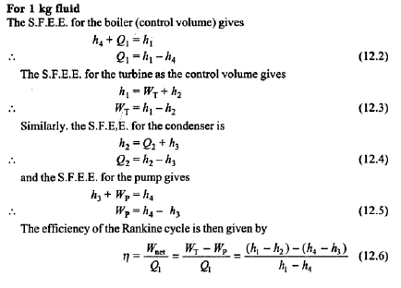

Slide 76
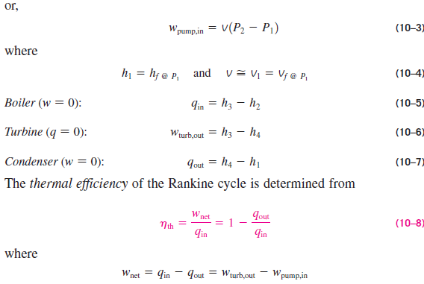

Slide 77
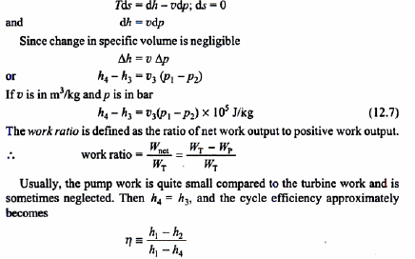
The pump handles liquid water which is incompressible, i.e., its density or specific volume undergoes little change with increase in pressure.
For reversible adiabatic compression, by the use of the general property relation

Slide 78
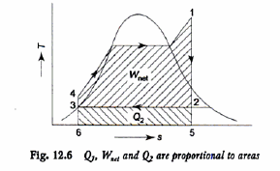
The efficiency of the Rankine cycle is presented graphically in the T-s plot in Fig. 12.6.
Thus Q1 is proportional to area 1564, Q2 is proportional to area 2563, and W net (= Q1 - Q2) is proportional to area 1 2 3 4 enclosed by the cycle.

Slide 79

STEAM RATE :
The capacity of a steam plant is often expressed in terms of steam rate, which is defined as the rate of steam flow (kg/h) required to produce unit shaft output (1 kW).
Therefore

Slide 80

HEAT RATE:
The cycle efficiency is sometimes expressed alternatively as heat rate which is the rate input (Q1) required to produce unit work output (l kW)

Slide 81
CARNOT CYCLE
We have mentioned repeatedly that the Carnot cycle is the most efficient cycle operating between two specified temperature limits.
Thus it is natural to look at the Carnot cycle first as a prospective ideal cycle for vapour power plants.
If we could, we would certainly adopt it as the ideal cycle.
As explained below, however, the Carnot cycle is not a suitable model for power cycles.

Slide 82
Throughout the discussions, we assume steam to be the working fluid since it is the working fluid predominantly used in vapor power cycles.
Consider a steady-flow Carnot cycle executed within the saturation dome of a pure substance, as shown in Fig. 10-1a.
The fluid is heated reversibly and isothermally in a boiler (process 1-2), expanded isentropically in a turbine (process 2-3), condensed reversibly and isothermally in a condenser (process 3-4), and compressed isentropically by a compressor to the initial state (process 4-1).

Slide 83
IMPRACTICALITIES ASSOCIATED WITH
CARNOT CYCLE

Slide 84
1. Isothermal heat transfer to or from a two-phase system is not difficult to achieve in practice since maintaining a constant pressure in the device automatically fixes the temperature at the saturation value.
Therefore, processes 1-2 and 3-4 can be approached closely in actual boilers and condensers.
Limiting the heat transfer processes to two-phase systems, however, severely limits the maximum temperature that can be used in the cycle (it has to remain under the critical-point value, which is 374°C for water).
Limiting the maximum temperature in the cycle also limits the thermal efficiency.
Any attempt to raise the maximum temperature in the cycle involves heat transfer to the working fluid in a single phase, which is not easy to accomplish isothermally.

Slide 85
2. The isentropic expansion process (process 2-3) can be approximated closely by a well-designed turbine.
However, the quality of the steam decreases during this process, as shown on the T-s diagram in Fig. 10–1a.
Thus the turbine has to handle steam with low quality, that is, steam with a high moisture content.
The impingement of liquid droplets on the turbine blades causes erosion and is a major source of wear.
Thus steam with qualities less than about 90 percent cannot be tolerated in the operation of power plants.
This problem could be eliminated by using a working fluid with a very steep saturated vapor line.

Slide 86
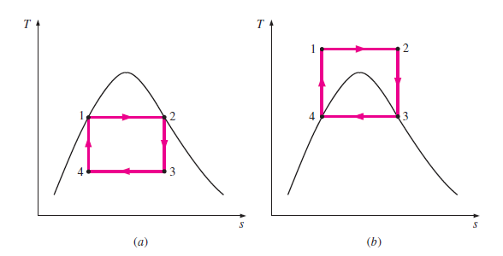


Slide 87
3. The isentropic compression process (process 4-1) involves the compression of a liquid–vapor mixture to a saturated liquid.
There are two difficulties associated with this process.
First, it is not easy to control the condensation process so precisely as to end up with the desired quality at state 4. Second, it is not practical to design a compressor that handles two phases.
Some of these problems could be eliminated by executing the Carnot cycle in a different way, as shown in Fig. 10–1b.
This cycle, however, presents other problems such as isentropic compression to extremely high pressures and isothermal heat transfer at variable pressures.
Thus we conclude that the Carnot cycle cannot be approximated in actual devices and is not a realistic model for vapor power cycles.

Slide 88
HOW CAN WE INCREASE THE EFFICIENCY OF THE RANKINE CYCLE?
Steam power plants are responsible for the production of most electric power in the world, and even small increases in thermal efficiency can mean large savings from the fuel requirements.
Therefore, every effort is made to improve the efficiency of the cycle on which steam power plants operate.
The basic idea behind all the modifications to increase the thermal efficiency of a power cycle.

Slide 89
Methods:
Increase the average temperature at which heat is transferred to the working fluid in the boiler,
or
Decrease the average temperature at which heat is rejected from the working fluid in the condenser.
That is, the average fluid temperature should be as high as possible during heat addition and as low as possible during heat rejection.
Next we discuss three ways of accomplishing this for the simple ideal Rankine cycle.

Slide 90
1. Lowering the Condenser Pressure (Lowers Tlow,avg)
Steam exists as a saturated mixture in the condenser at the saturation temperature corresponding to the pressure inside the condenser.
Therefore, lowering the operating pressure of the condenser automatically lowers the temperature of the steam, and thus the temperature at which heat is rejected.
The effect of lowering the condenser pressure on the Rankine cycle efficiency is illustrated on a T-s diagram in Fig. 10–6.

Slide 91
For comparison purposes, the turbine inlet state is maintained the same.
The coloured area on this diagram represents the increase in net work output as a result of lowering the condenser pressure from P4 to P4’.
The heat input requirements also increase (represented by the area under curve 2’-2), but this increase is very small.
Thus the overall effect of lowering the condenser pressure is an increase in the thermal efficiency of the cycle.

Slide 92
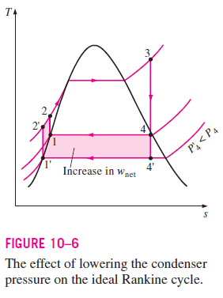

Slide 93
2. Superheating the Steam to High Temperatures (Increases Thigh, avg)
The average temperature at which heat is transferred to steam can be increased without increasing the boiler pressure by superheating the steam to high temperatures.
The effect of superheating on the performance of vapor power cycles is illustrated on a T-s diagram in Fig. 10–7.
The colour area on this diagram represents the increase in the net work.
The total area under the process curve 3-3’ represents the increase in the heat input.

Slide 94
Thus both the net work and heat input increase as a result of superheating the steam to a higher temperature.
The overall effect is an increase in thermal efficiency, however, since the average temperature at which heat is added increases,
Superheating the steam to higher temperatures has another very desirable effect.
It decreases the moisture content of the steam at the turbine exit, as can be seen from the T-s diagram (the quality at state 4’ is higher than that at state 4).

Slide 95
The temperature to which steam can be superheated is limited, however, by metallurgical considerations.
Presently the highest steam temperature allowed
at the turbine inlet is about 620°C (1150°F).
Any increase in this value depends on improving the present materials or finding new ones that can withstand higher temperatures.
Ceramics are very promising in this regard.

Slide 96
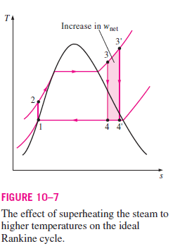

Slide 97
3. Increasing the Boiler Pressure (Increases Thigh,avg)
Another way of increasing the average temperature during the heat-addition process is to increase the operating pressure of the boiler, which automatically raises the temperature at which boiling takes place.
This, in turn, raises the average temperature at which heat is transferred to the steam and thus raises the thermal efficiency of the cycle.

Slide 98
The effect of increasing the boiler pressure on the performance of vapour power cycles is illustrated on a T-s diagram in Fig. 10–8.
Notice that for a fixed turbine inlet temperature, the cycle shifts to the left and the moisture content of steam at the turbine exit increases.
This undesirable side effect can be corrected, however, by reheating the steam, as discussed in the next section.
Operating pressures of boilers have gradually increased over the years from about 2.7 MPa (400 psia) in 1922 to over 30 MPa (4500 psia) today, generating enough steam to produce a net power output of 1000 MW or more in a large power plant.

Slide 99
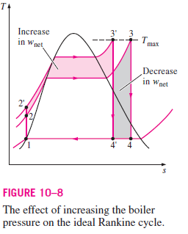

Slide 100
Today many modern steam power plants operate at supercritical pressures (P 22.06 MPa) and have thermal efficiencies of about 40 percent for fossil-fuel plants and 34 percent for nuclear plants.
There are over 150 supercritical-pressure steam power plants in operation in the United States.
The lower efficiencies of nuclear power plants are due to the lower maximum temperatures used in those plants for safety reasons.
The T-s diagram of a supercritical Rankine cycle is shown in
Fig. 10–9.

Slide 101
